Slide 1
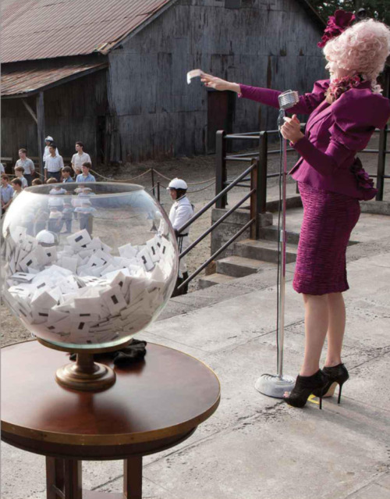
Starter
Complete ‘The Reaping’ worksheet. Fill in the grid.
Answer the task questions 1-3 in your books. (Use full sentences!)

Slide 2
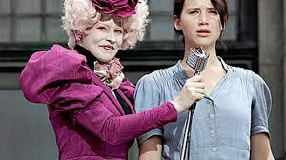

Chapter 2
Let’s read Chapter 2 together…
Whilst we are reading, consider how Collins portrays the character of Effie Trinket.

Slide 3
Learning Question: How can I understand what a writer is trying to tell me?
How do these quotations show inequality?
“But here’s the catch. Say you’re poor and starving, as we were. You can opt to add your name more times in exchange for tesserae.” Page 15
“The reaping system is unfair, with the poor getting the worst of it.” Page 15
“The competition will be far beyond my capabilities. The kids who win will be kids from wealthier districts, where winning is a huge honour, who’ve been trained their whole lives for this.” Page 44
Where have we seen inequality within District 12?

Slide 4
Learning objectives
To explore a key theme of the novel.
To analyse one of the motifs of the novel.

Slide 5
Mockingjay
Consider:
What significances does the mockingjay pin have for Katniss?
What could the mockingjay become a symbol for?

